Slide 1
Introduction to Ethernet Cables

Slide 2
Types of Ethernet cabling
To start off with, you should know that not all Ethernet cabling is the same. If you go to a store you may find a variety of “categories” of cabling. These categories tell you the quality of the cabling. The quality determines, essentially, how much the cable can handle. Here are the categories that you need to know:
Cat 3 – used for voice cabling and 10Mb Ethernet
Cat 5 – used for 10/100Mb Ethernet and works for voice as well
Cat 5E – Enhanced Cat 5 cabling that helps to prevent cross-talk, works for 10/100Mb and 1000Mb (or Gigabit Ethernet)
Cat 6 – Like Cat 5E but with larger gauge wires, works for 10/100/1000Mb. This cable is better than Cat 5e for Gigabit Ethernet.
Cat 7 – Also called Class F, this is fully-shielded cabling and supports up to 600Mhz. This is a relatively new type of cabling and isn’t used much.
Most companies today are still using and even installing Category 5e as it works for the 100Mb Fast-Ethernet in use on almost every desktop PC. Plus, it is economical compared to the higher categories of cabling. If you go to a computer store and buy an Ethernet cable, 99% of the time it will be a Cat 5e cable.

Slide 3
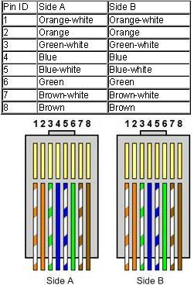
Straight Cable
You usually use straight cable to connect different type of devices. This type of cable will be used most of the time and can be used to:
1) Connect a computer to a switch/hub's normal port.
2) Connect a computer to a cable/DSL modem's LAN port.
3) Connect a router's WAN port to a cable/DSL modem's LAN port.
4) Connect a router's LAN port to a switch/hub's uplink port. (normally used for expanding network)
5) Connect 2 switches/hubs with one of the switch/hub using an uplink port and the other one using normal port.

Slide 4
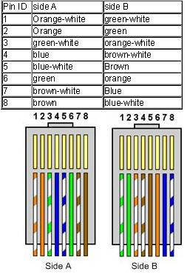
Crossover Cable
Sometimes you will use crossover cable, it's usually used to connect same type of devices. A crossover cable can be used to:
1) Connect 2 computers directly.
2) Connect a router's LAN port to a switch/hub's normal port. (normally used for expanding network)
3) Connect 2 switches/hubs by using normal port in both switches/hubs.

Slide 5
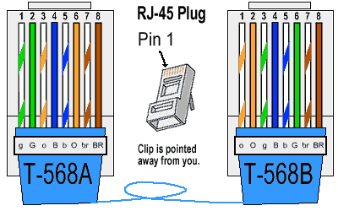
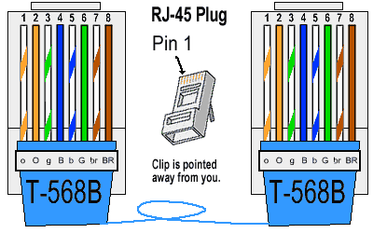
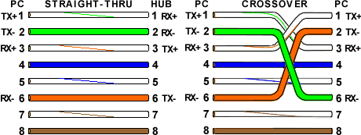
Basic Theory

Slide 6
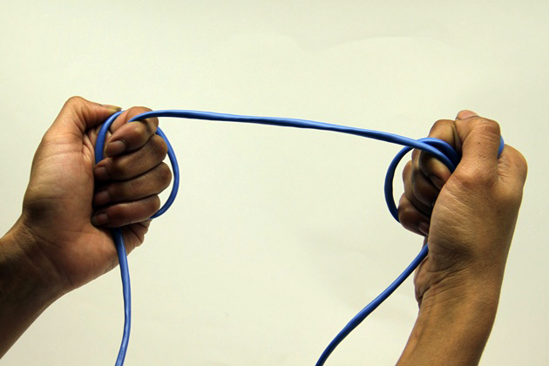
How To Make Ethernet Cables
Step 1
Determine which type of cable you need. Newer networking hardware, adapters, NASes, switches and routers are connected with what's called a straight through cable. This is the type of Ethernet cable that generally ships with today's networking devices. In some cases you'll need a cross-over cable for , connecting older devices by their switches switches or connecting two hubs (a technique called daisy-chaining), or connecting two older laptops to each other (for file transferring, for example. Cross-over cables are rarely needed for networking hardware that's only about three or fours years old, thanks to a technology known as Auto-MDIX, which can automatically sense on network ports if a straight through or cross-over connection is needed and will make the appropriate connection. However, if you want to link older equipment, check your device's documentation to see if the connection requires a cross-over cable.

Slide 7
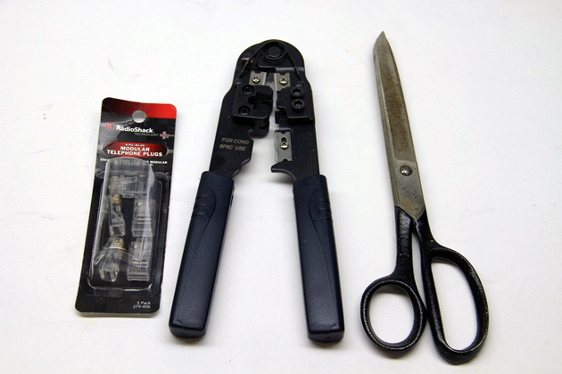
Step 2
Get the right tools. You will need a spool of Cat5 (Cat5e is now the standard) or Cat6 (if your network is Gigabit Ethernet) cable. Cat5 or Cat6 cable can have plenum or PVC jackets. PVC cable is cheaper, but it also releases a toxic smoke if it catches on fire, so some building codes prohibit it. Plenum, on the other hand, does not release these toxic fumes. If you have no prohibitions preventing the use of PVC and are new to making Ethernet cables, your best bet is to start with PVC coated cable. It's cheaper and easier to work with because the wiring is not as soft as a Plenum cable's. You'll also need RJ-45 plugs or "heads" plastic modular plugs that terminate both ends of the cable, a wire cutter (or a good, sharp pair of scissors), a wire stripper and an RJ-45 crimper. The crimper is used to secure the heads at each end of the wire. You can purchase crimpers, cable and plugs from a slew of online stores or Radio Shack.

Slide 8
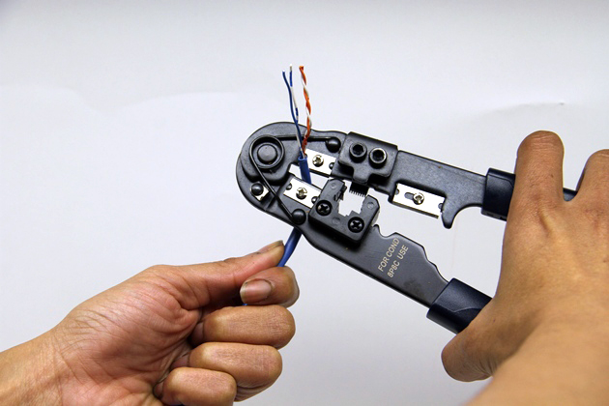
Step 3
Cut the wire to the desired length and strip about an inch of the jacket off, exposing the four twisted pairs of inner wiring. When stripping the cable, be careful not to nick the wires. This can cause problems with the connection. Do this at both ends of the cable.

Slide 9
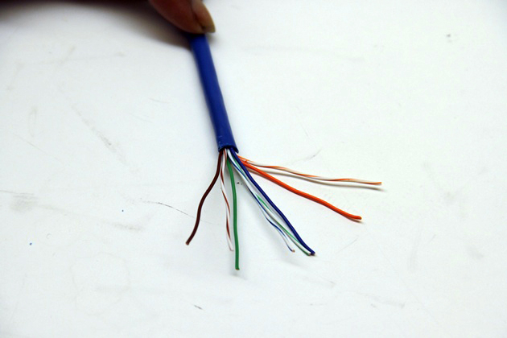
Step 4
Prepare your wire for termination or "crimping". Untwist the wire. Arrange your wires based on whether you need a straight through or crossover cable. For a straight through, arrange the wires, on both ends as you are holding and looking at the cable, from left to right: white-orange, orange, white-green, blue, white-blue, green, white-brown, brown. For a cross-over cable, the wire arrangement is different at both ends. At one end, arrange as follows: white-green, green, white-orange, blue, white-blue, orange, white-brown, brown. At the other end, arrange as you would for a straight-through cable: white-orange, orange, white-green, blue, white-blue, green, white-brown, brown.

Slide 10
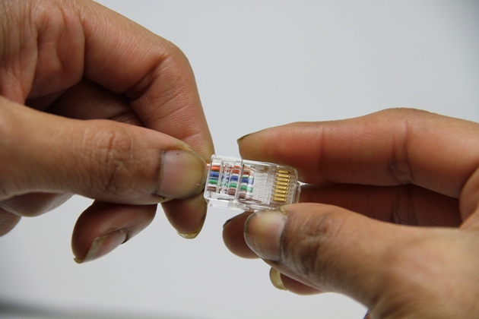
Step 5
Terminate the cable at both ends. Straighten the wires out as much as possible; it will make them easier to place inside of the RJ-45 plug. Get the wires as close to one another as possible, holding them between your thumb,index, and middle fingers. Trim the wires down evenly to about a quarter of an inch. Here's the tricky part that may take some practice: slip the wires inside of the RJ-45 plug with the clip-side down. Don't try to jam the wires in, they should slip inside the clip and fit snug. You don't want to see any wires between the plug and the jacket; you want just a bit of the jacket going into the plug. You also want to make sure each wire is making contact with the gold leads in the plug. Take the crimper and crimp down on the plug, pressing the crimper firmly, but not too hard.

Slide 11
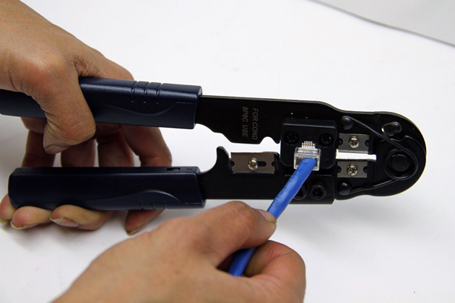
Step 6
Take the crimper and crimp down on the plug, pressing the crimper firmly, but not too hard.

Slide 12
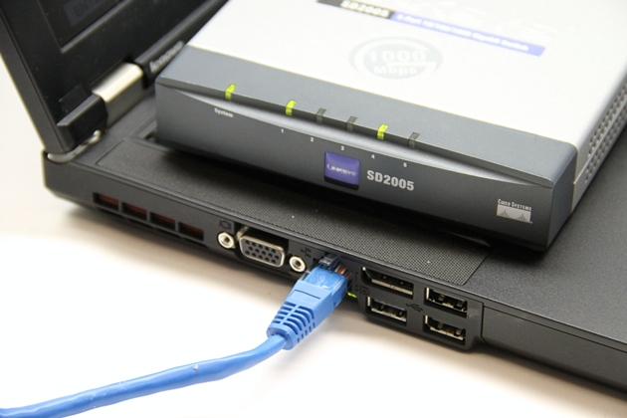
Step 7
Test the cable. Connect a networking device with an LED indicating network activity to your network using the cable you created. Ensure you are getting a strong signal.

